Slide 1
Smart attendance System based on facial Recognition
Sushan Bhojak- AU1940200
Priya Bhoraniya- AU1940173
Dhruvanshu Parmar- AU1940166
CSE523 Machine Learning
Course Instructor : Prof. Mehul Raval

Slide 2
Introduction
In this project, the Open CV based face recognition approach has been proposed.
This model integrates a camera that captures an input image, an algorithm for detecting face from an input image, encoding and identifying the face, marking the attendance in a spreadsheet.
A facial recognition system is a computerized biometric software which is suited for determining or validating a person by performing comparison on patterns based on their facial appearances.

Slide 3
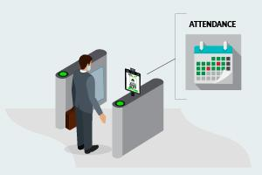
Problem Statement
The purpose of this project is to create a model which integrates a camera that captures an input image, an algorithm for detecting face from an input image, encoding and identifying the face, marking the attendance in a spreadsheet.
Given still or video images of a scene identify or verify one or more person in the scene using a stored databases of faces.
The project can be divided into three parts, first part is face detection , second part is face recognition and the third part is marking attendance in spreadsheet.

Slide 4
Existing Body Of Work
At current level the module is taking input from predetermined data and comparing with given test data.
Here our module is implementing the pre-loaded train images with face detection, face extraction and feature extraction while using SVM classification to establish logic, here the accuracy of model is shown with multiple face in frame the module is able to predict the right output.

Slide 5
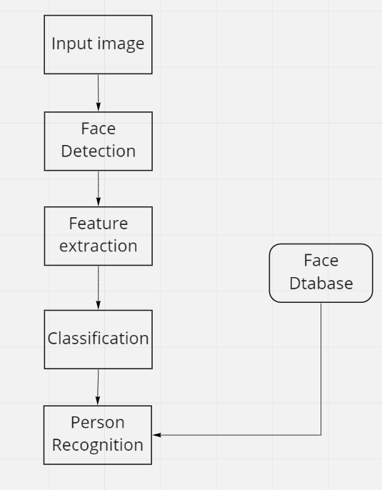
APPROACH

Slide 6
Face Detection: Face Recognition:
Paul Viola and Michael Jones
Histogram of Oriented Gradients
Canny Edge Detection
SIFT (Scale Invariant Feature Transform)
There are various algorithms used for facial recognition. Some of them are as follows:
1. Eigenfaces
2. Fisher faces
3. Local binary patterns histograms

Slide 7
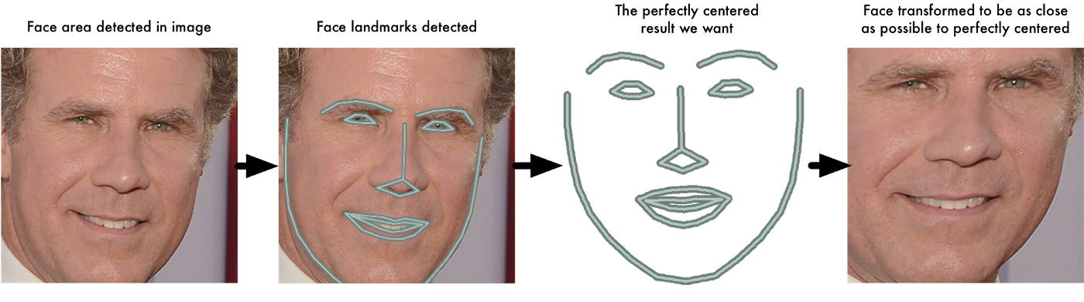
Types of Libraries and Modules Used:
Face landmark estimation

Slide 8
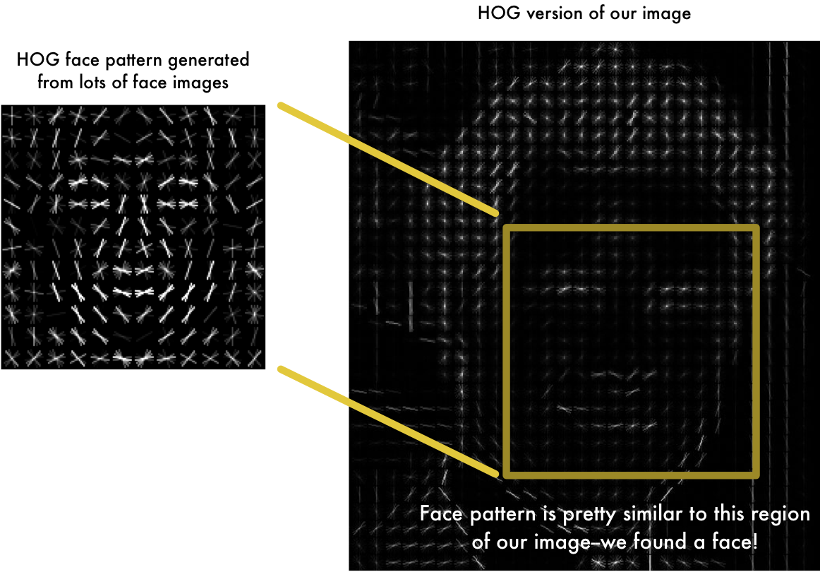
Types of Libraries and Modules Used

Slide 9
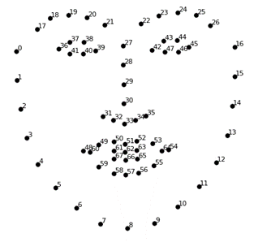
SVM Classifier
SVM maps training examples to points in space so as to
maximize the width of the gap between the two
categories.
We demonstrate our SVM-based algorithm on both
verification and identification applications. In
identification, the algorithm is presented with an image
of an unknown person. The algorithm reports its best
estimate of the identity of an unknown person from a
database of known individuals.

Slide 10
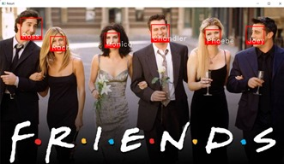
Output:
Face detection and face identification is implemented

Slide 11
Future Work
The program in place at the moment, for this project has limitations in terms of the number of user inputs, variables, constraints, and even efficiency which could be resolved by using different algorithms and different approaches but they require advanced mathematical and computational applications, which could be achieved at later stages.

Slide 12
Contribution
 | RESEARCH | IMPLEMENTATION | CODING | REPORT | PPT
SUSHAN | YES | NO | YES | NO | YES
PRIYA | YES | YES | YES | NO | NO
DHRUVANSHU | YES | NO | YES | YES | NO

Slide 13
References:
https://pypi.org/project/face-recognition/(Offical py page)
https://towardsdatascience.com/face-detection-for-beginners-e58e8f21aad9
https://www.analyticsvidhya.com/blog/2021/06/build-an-image-classifier-with-svm/
https://medium.com/analytics-vidhya/face-recognition-using-knn-open-cv-9376e7517c9f
S. Dev and T. Patnaik, "Student Attendance System using Face Recognition," 2020 International Conference on Smart Electronics and Communication (ICOSEC), 2020, pp. 90-96, doi: 10.1109/ICOSEC49089.2020.9215441. https://ieeexplore.ieee.org/document/9215441

Slide 14
Created By
Sushan Bhojak- AU1940200
Dhruvanshu Parmar- AU1940166
Research &implementation:
Sushan Bhojak
Priya Bhoraniya
Report Writing & Documentation:
Dhruvanshu Parmar
Priya Bhoraniya- AU1940173

Slide 15
THANK
YOU!

